Slide 1
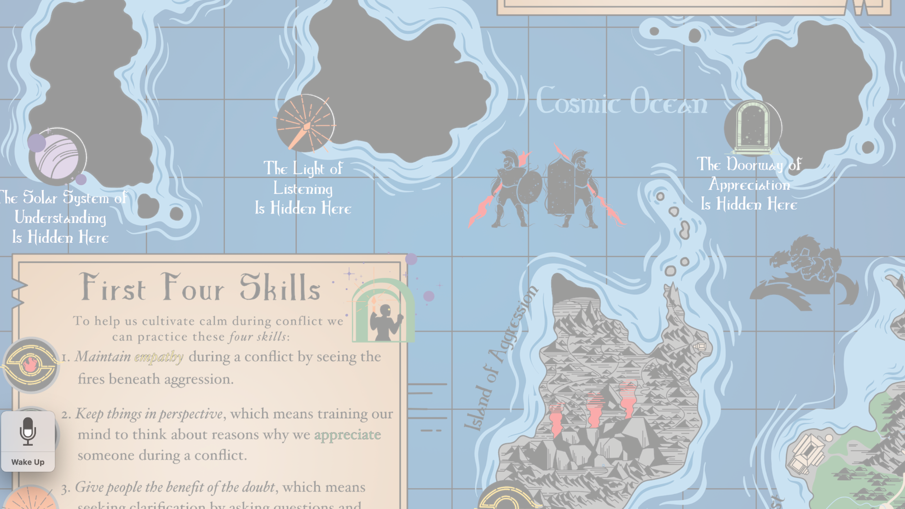
Navigating the
Island of Aggression:
The Fires Beneath Aggression

Slide 2
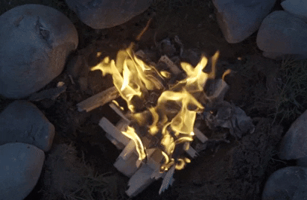
Think of aggression as being like heat emitted from a fire.

Slide 3
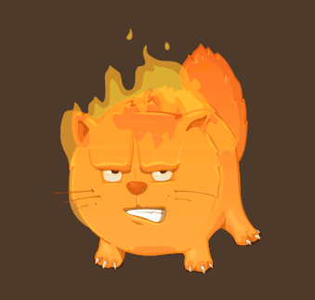
Aggression is like heat emitted from a fire.
Think of the fire as pain and distress.
People don’t become aggressive because they feel good.
Notes:
Different chemicals create different color flames.

Slide 4
Aggression is a distress response.
Key Idea:

Slide 5


Slide 6
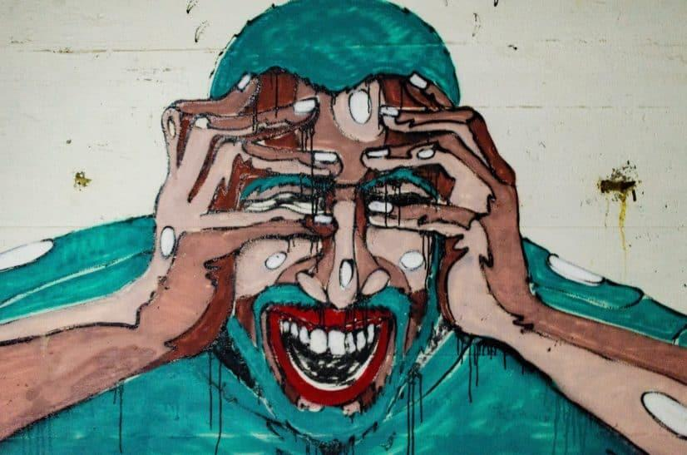
Anger (aggression) can sometimes feel overpowering.

Slide 7
The Root Cause
The root cause of a problem is the basic reason for the problem, the underlying cause of the problem
For example, you may sneeze, but that doesn’t mean there is something wrong with your nose.
The root cause of your sneezing may be allergies, or a cold.
Distress is the root cause of aggression.

Slide 8
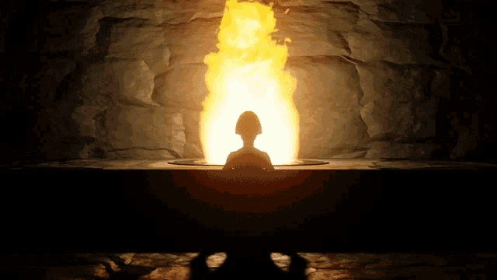
Finding the root causes of aggression
can help us to better respond to a conflict.

Slide 9
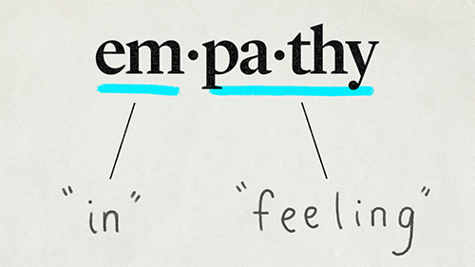
Empathy is the ability to understand and share the feelings of another person.
Notes:
Animate so image shows first, then definition on spacebar click

